Slide 1
INTRODUCTION TO ACADEMIC WRITING
Tharindu Jayamanna Diploma in English and English Language Teaching (OUSL) Advanced Diploma in English Language and Literature (ICHA-UK) BA (Hons.) in English and English Language Teaching (OUSL) MA in teaching English Literature in an ESL context (PGIE)

Slide 2
SESSION OBJECTIVES
Differentiate between informal writing and Academic writing as a genre
Study the main features of Academic Writing

Slide 3
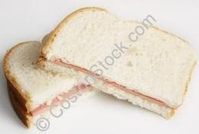
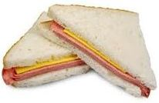
What is Academic Writing?
A
B
C

Slide 4
Different Narrative Styles
1st Person Narrative Style
Use of ‘I’ or ‘We’
2nd Person Narrative Style
Use of ‘You’ and ‘Your’
3rd Person Narrative Style
Use of ‘He, She, It and They’

Slide 5
Why different narrative styles?
I love you!
He loves you!
You love me!
I cheated!
She cheated!
You cheated!

Slide 6
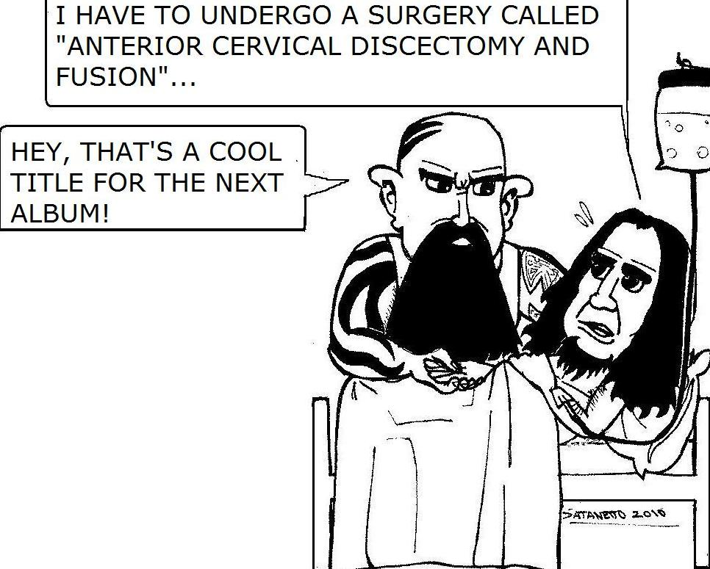
Formal vs. Informal

Slide 7
Objective Writing vs. Subjective Writing
Direct and straightforward language
vs.
Indirect and implicit language
WHICH ONE IS MORE ACADEMIC? Why?

Slide 8
What are the general rules?

Slide 9
Active or Passive?
Why do we use active?
Why do we use passive?
Which one is formal?

Slide 10
Active and Passive
S V O
O V S
How many active forms and passive forms?

Slide 11
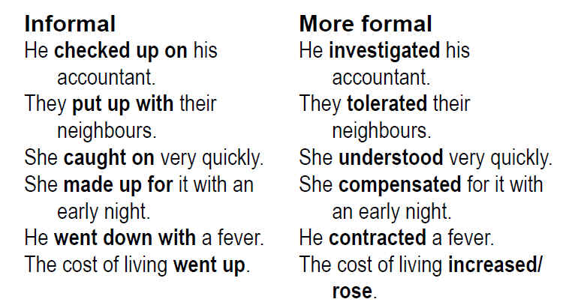
Academic register

Slide 12
Idioms and Phrasal Verbs?
It’s raining cats dog or heavy showers?
Pull up your socks or get ready?
Struck my mind or realized?

Slide 13
Punctuation

Slide 14
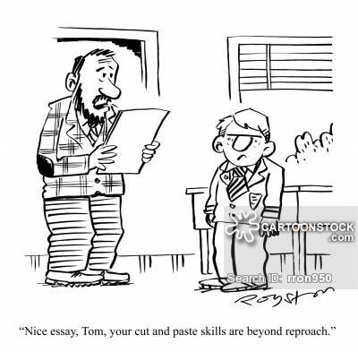
Verbatim and Plagiarism

Slide 15
Acknowledge sources
What is referencing?
What is citing?
What is bibliography?

